Slide 3
Dreaming of a new kingdom

Slide 4
O God, our Strength, we put our trust in You. You have never forsaken those who seek You. You have never let us down. We know that You never will let us down because our lives so far has been a testimony of Your greatness.

Slide 5
Form us into Your image, and hold us close to You. Show us how to mature as a Christian and improve our walk of faith. Steady our trust in You so that it never wavers, no matter what battles we face on this earth. Amen.

Slide 6
Opening Song: Our God is A Great Big God

Slide 7
Notices

Slide 9
Explorers

Slide 10
Collect – a gathering prayer Faithful Creator, whose mercy never fails: deepen our faithfulness to you and to your living Word, Jesus Christ our Lord.Amen

Slide 11
Confession
God our Father,
we come to you in sorrow for our sins.
For turning away from you,
and ignoring your will for our lives;
Father, forgive us:
All save us and help us.

Slide 12
For behaving just as we wish,
without thinking of you;
Father, forgive us:
All save us and help us.
For failing you by what we do,
and think and say;
Father, forgive us:
All save us and help us.

Slide 13
For letting ourselves be drawn away from you
by temptations in the world about us;
Father, forgive us:
All save us and help us.
For living as if we were ashamed
to belong to your Son;
Father, forgive us:
All save us and help us.

Slide 14
Absolution
May the God of all healing and forgiveness
draw us to himself,
and cleanse us from all our sins
that we may behold the glory of his Son,
the Word made flesh,
Jesus Christ our Lord.
All Amen.

Slide 15
2nd Song This is Our God

Slide 16
Reading - Daniel 2

Slide 17
Sermon

Slide 18
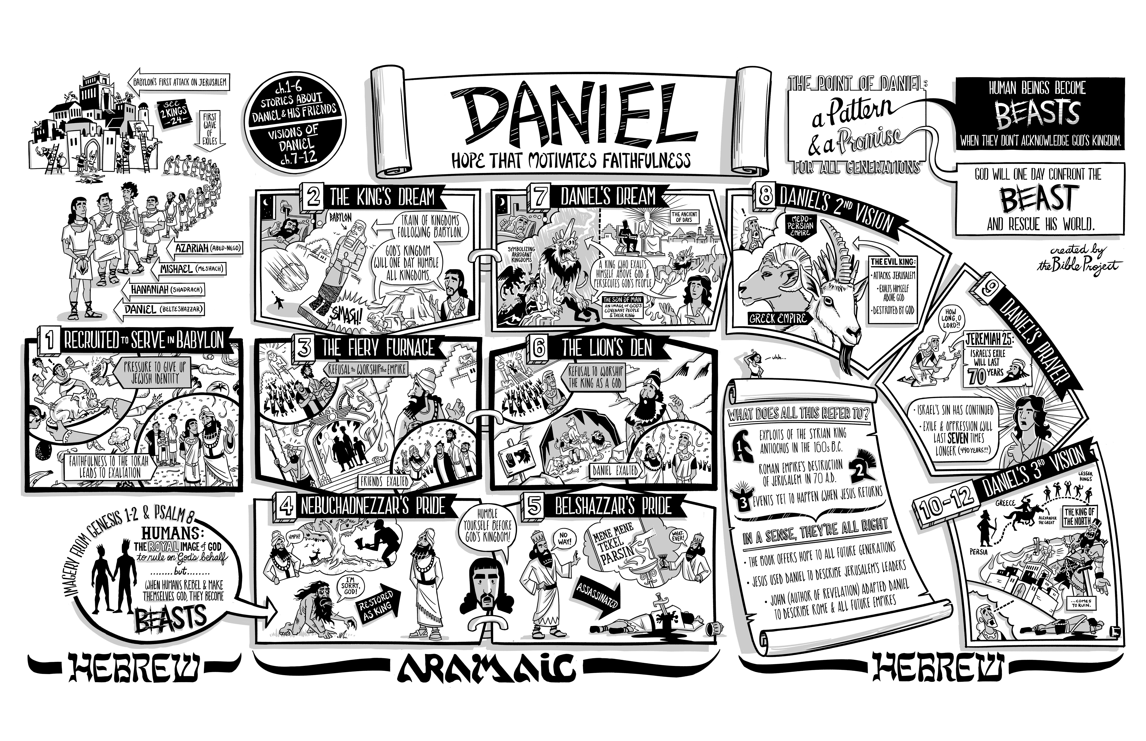

Slide 19
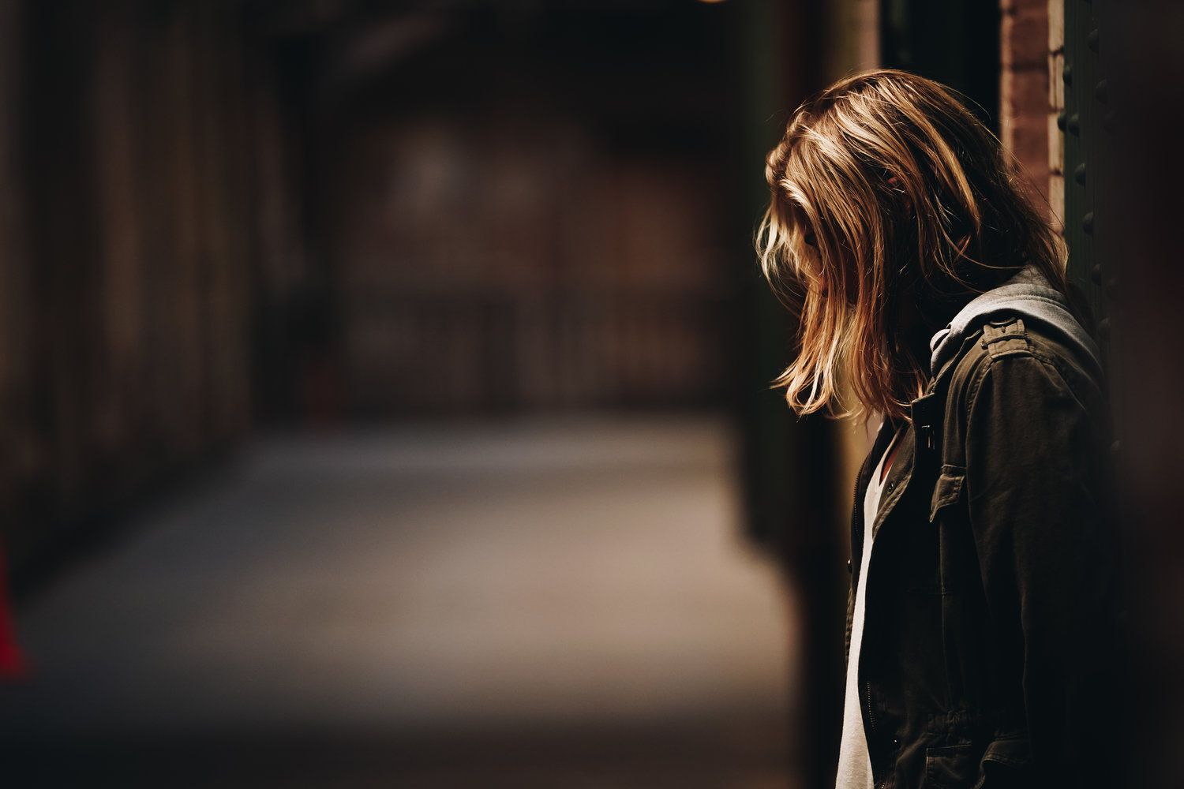
Have you ever had the feeling that something is wrong?

Slide 20
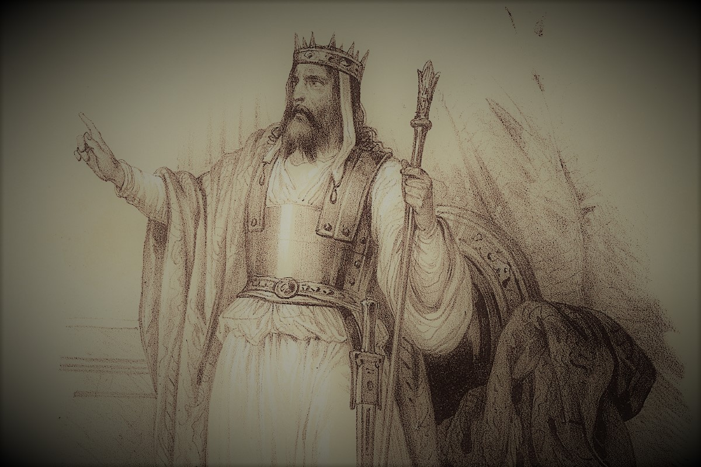
Nebuchadnezzar seeks understanding

Slide 21
First from his court

Slide 22
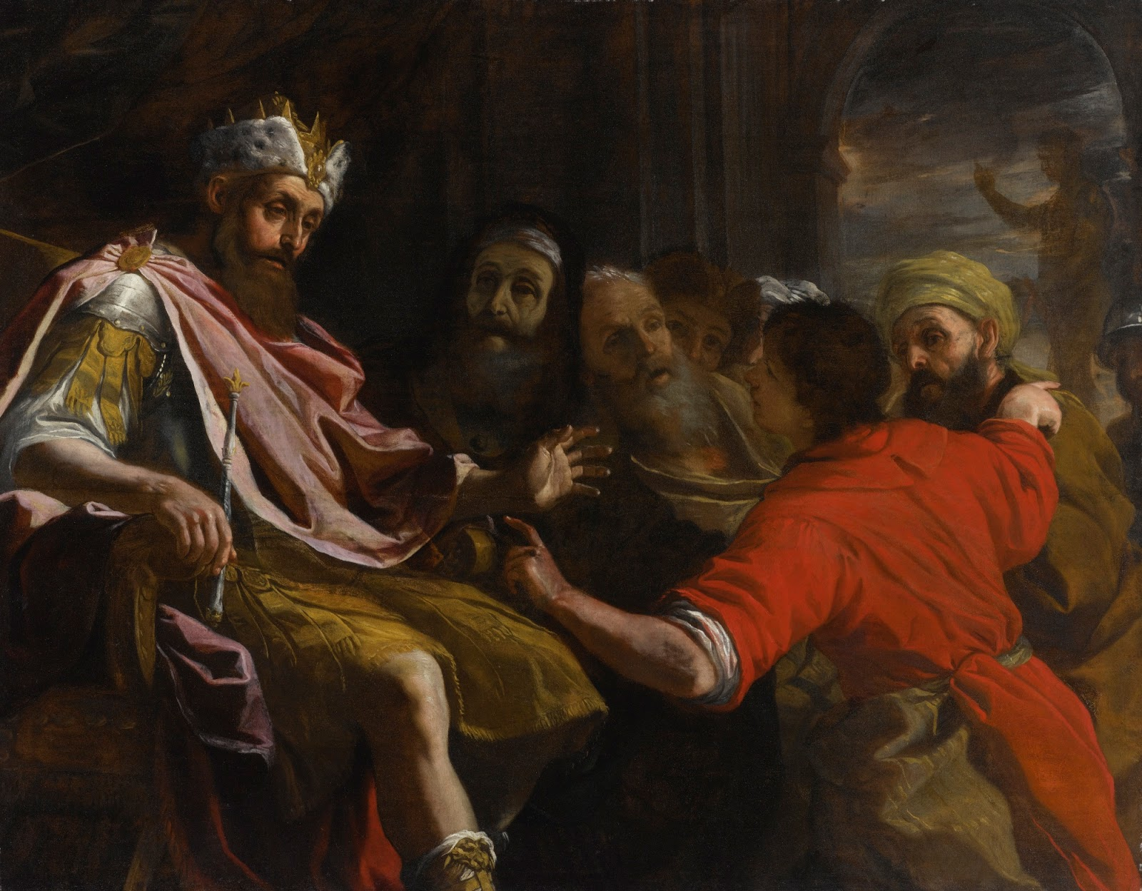
The excuses (vs 10-11)
No human can do this
Only Gods can do this

Slide 24
The Kings anger

Slide 25
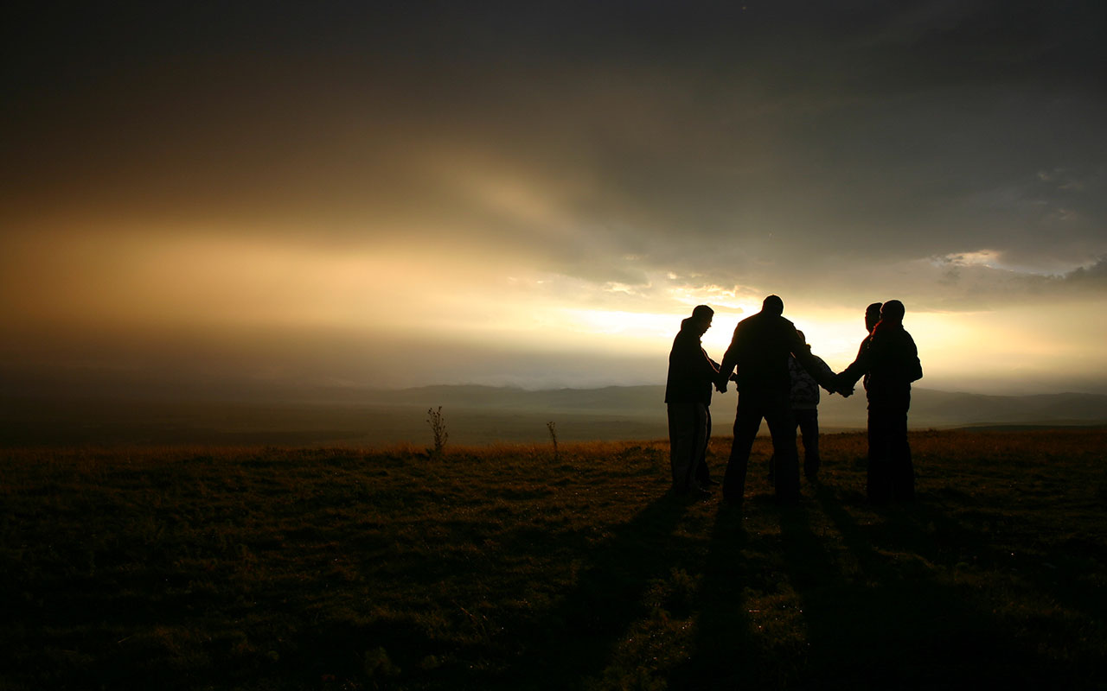
Daniel calls his friends to prayer and the dream is revealed
(vs 17-23)

Slide 26
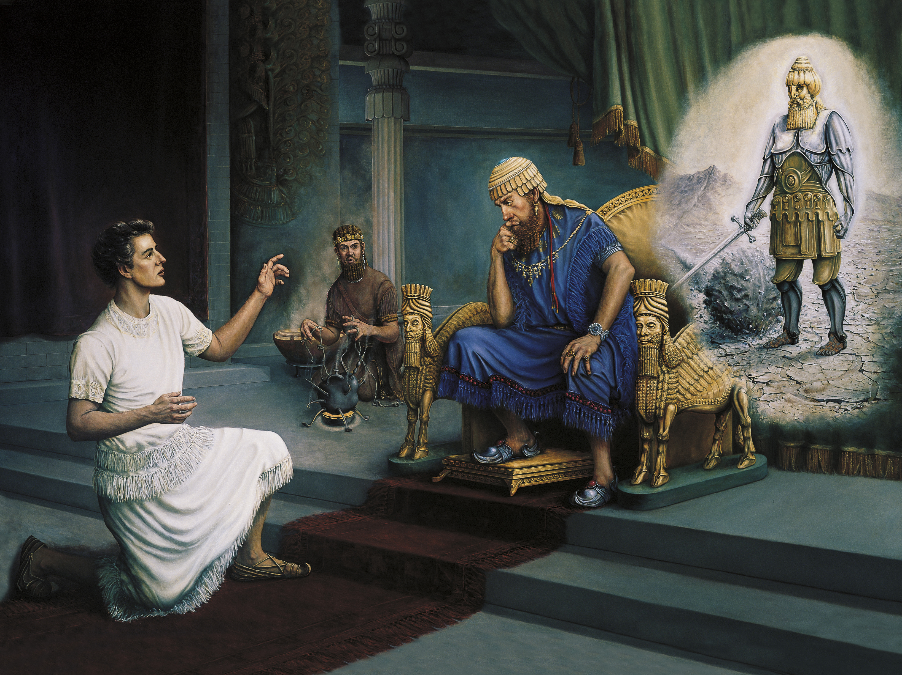
Daniel Reveals the power of God (vs 27-28)

Slide 28
The dream revealed
(vs 29-45)

Slide 30
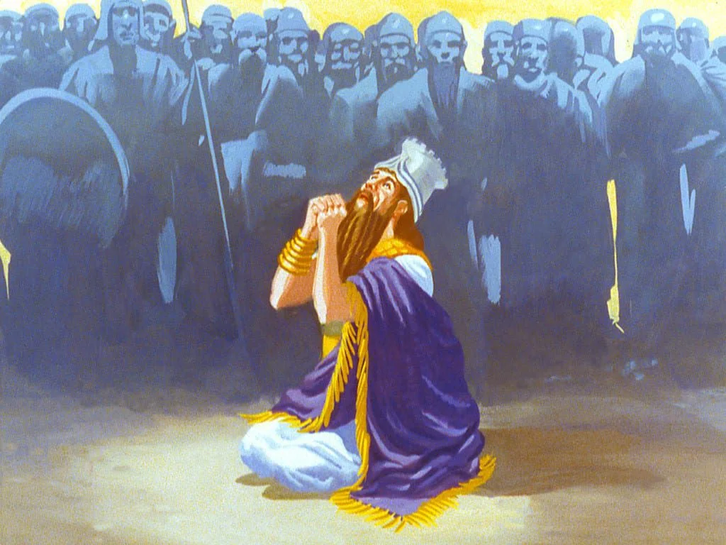

Slide 31
How should this help us as believers?
1) We can maintain a calm composure not matter what because of the object of our faith
2) We should maintain a constant prayer life to maintain our confidence in Christ
3) We can answer the questions that people have about this life.

Slide 32
Creed
I believe in God, the Father almighty,
creator of heaven and earth.
I believe in Jesus Christ, his only Son, our Lord,
who was conceived by the Holy Spirit,
born of the Virgin Mary,
suffered under Pontius Pilate,
was crucified, died, and was buried;

Slide 33
he descended to the dead.
On the third day he rose again;
he ascended into heaven,
he is seated at the right hand of the Father,
and he will come to judge the living and the dead.

Slide 34
I believe in the Holy Spirit,
the holy catholic Church,
the communion of saints,
the forgiveness of sins,
the resurrection of the body,
and the life everlasting.
Amen.

Slide 35
A Thousand Hallelujahs Blessed Be You Name

Slide 36
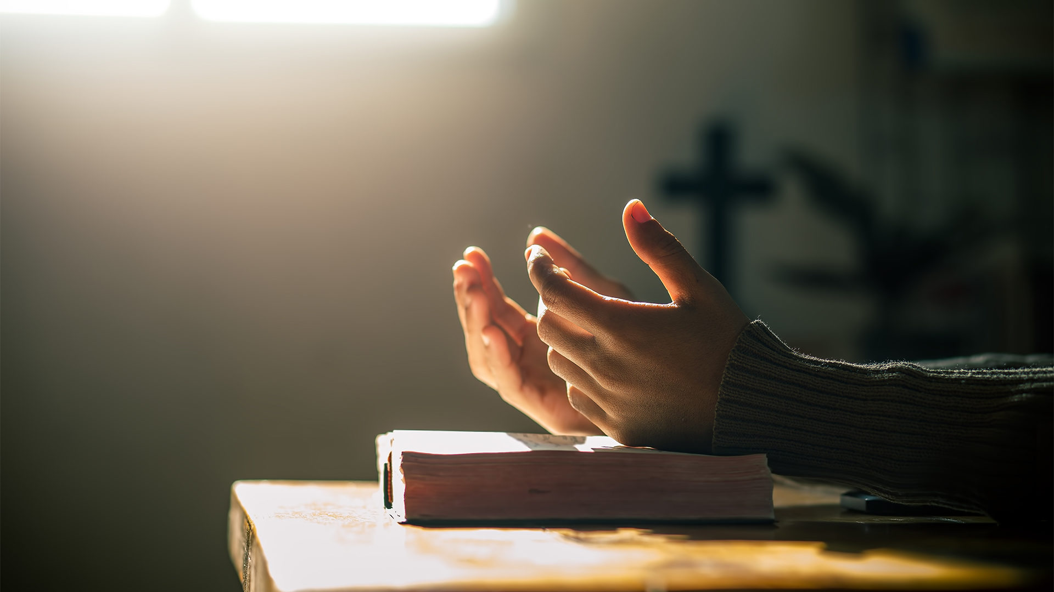
Prayer

Slide 37
Our Father in heaven,
hallowed be your name,
your kingdom come,
your will be done,
on earth as in heaven.
Give us today our daily bread.

Slide 38
Forgive us our sins
as we forgive those who sin against us.
Lead us not into temptation
but deliver us from evil.
For the kingdom, the power,
and the glory are yours
now and for ever.
Amen

Slide 39
Final Song: You Love Is Amazing

Slide 40
Blessing

