Slide 1
Spiritual gifts – the gifts that keep on giving

Slide 2


Slide 3
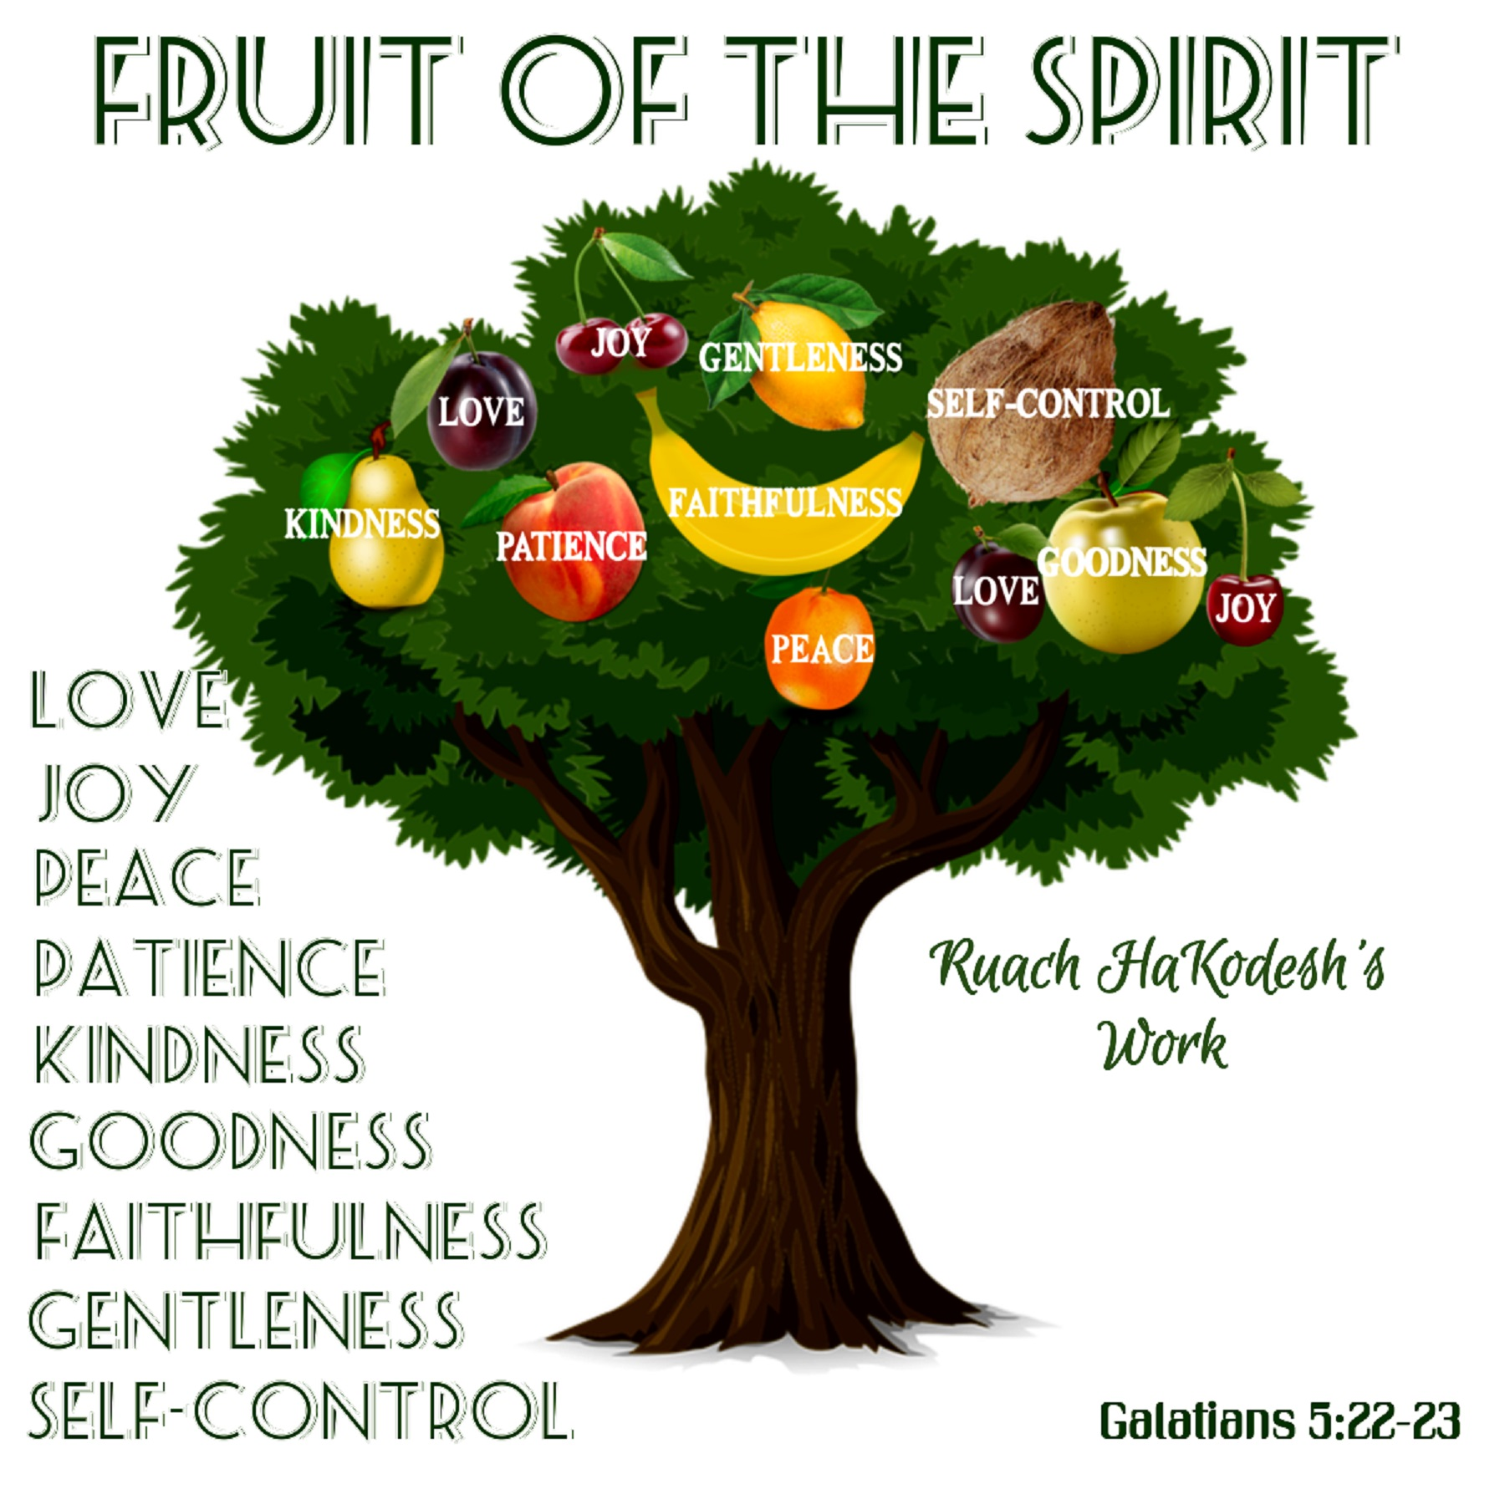

Slide 4


Slide 5
≠

Slide 6

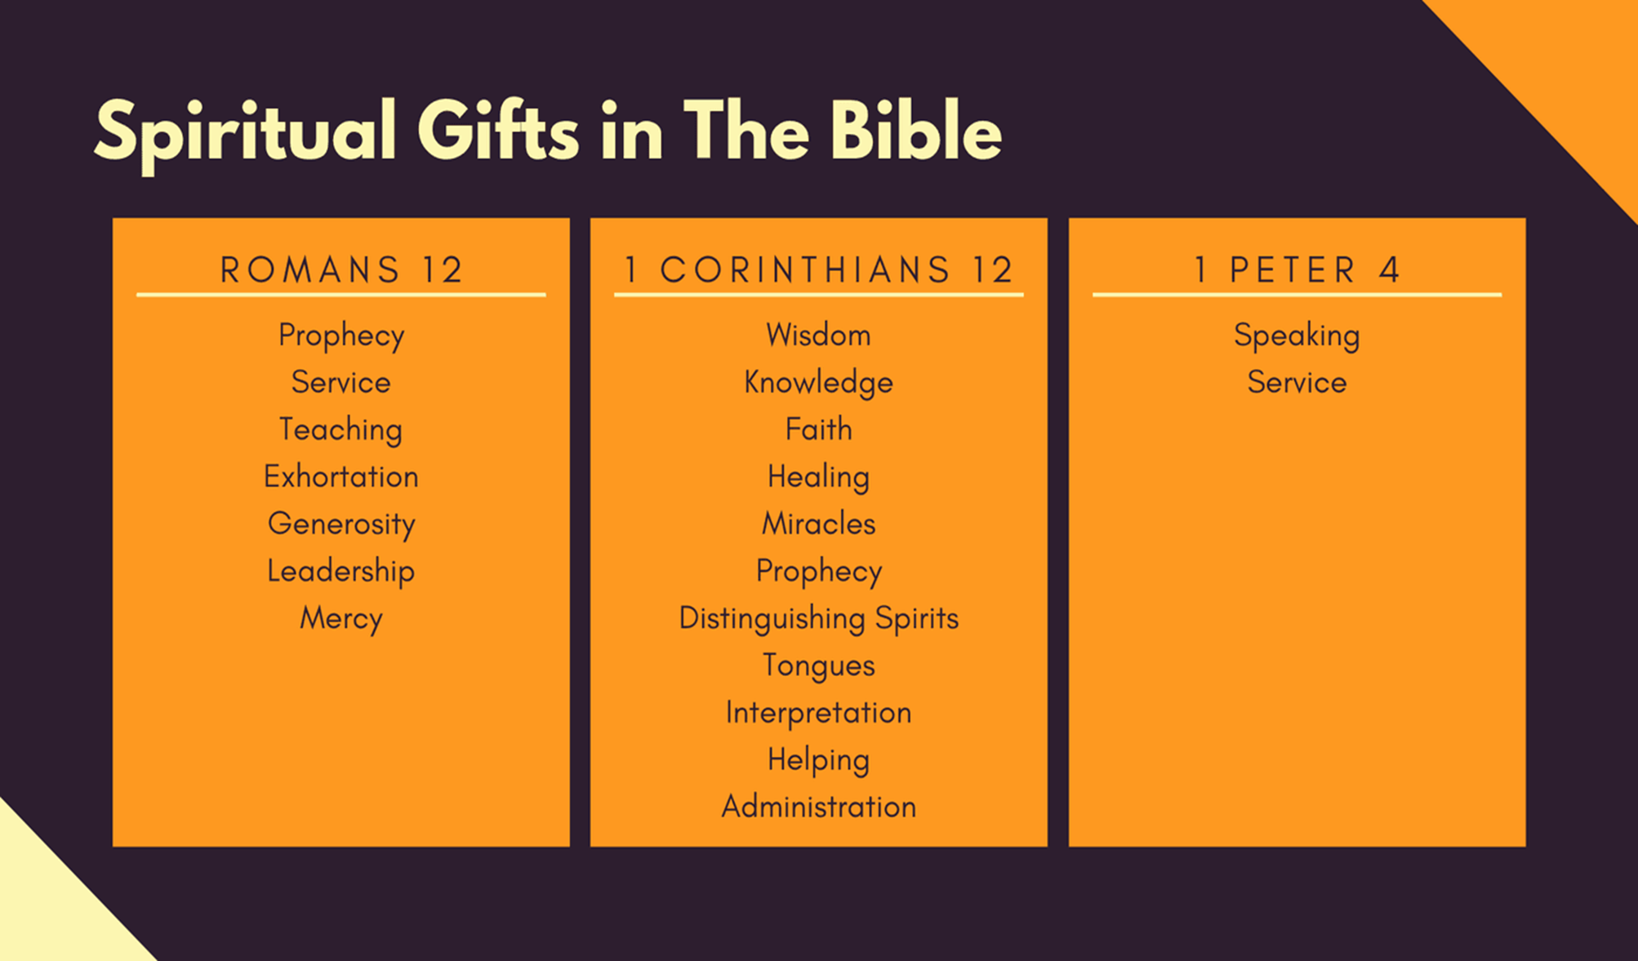

Slide 7
12 Now about the gifts of the Spirit, brothers and sisters, I do not want you to be uninformed. 2 You know that when you were pagans, somehow or other you were influenced and led astray to mute idols. 3 Therefore I want you to know that no one who is speaking by the Spirit of God says, “Jesus be cursed,” and no one can say, “Jesus is Lord,” except by the Holy Spirit.
4 There are different kinds of gifts, but the same Spirit distributes them.

Slide 8


Slide 9
12 Now about the gifts of the Spirit, brothers and sisters, I do not want you to be uninformed. 2 You know that when you were pagans, somehow or other you were influenced and led astray to mute idols. 3 Therefore I want you to know that no one who is speaking by the Spirit of God says, “Jesus be cursed,” and no one can say, “Jesus is Lord,” except by the Holy Spirit.
4 There are different kinds of gifts, but the same Spirit distributes them.

Slide 10
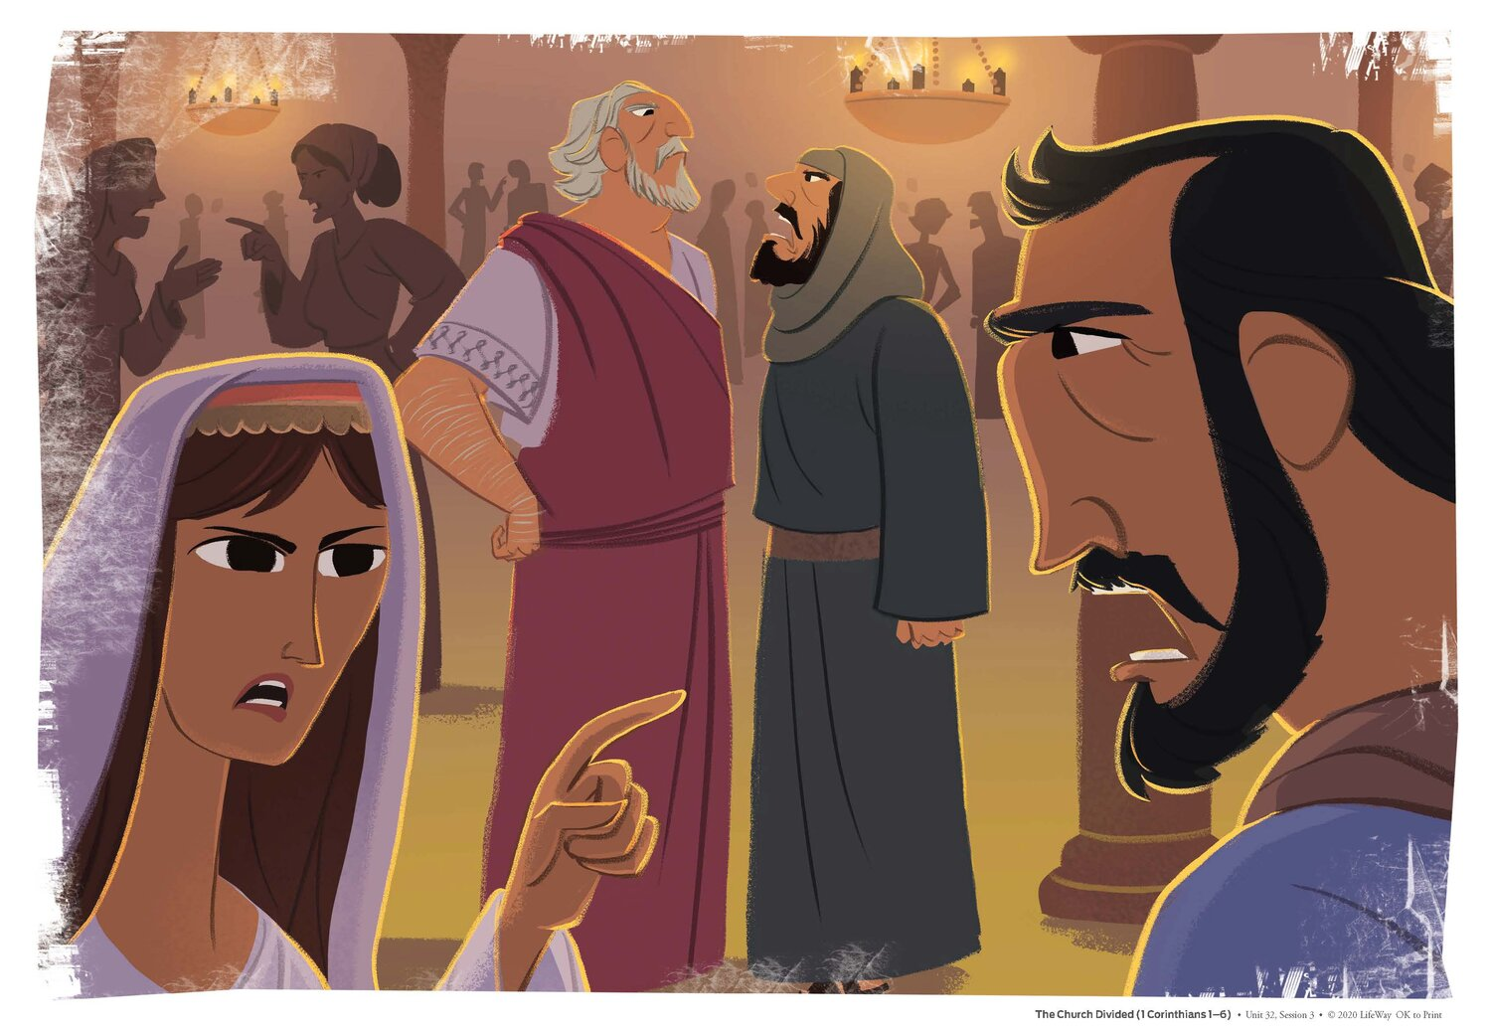

Slide 11
12 Now about the gifts of the Spirit, brothers and sisters, I do not want you to be uninformed. 2 You know that when you were pagans, somehow or other you were influenced and led astray to mute idols. 3 Therefore I want you to know that no one who is speaking by the Spirit of God says, “Jesus be cursed,” and no one can say, “Jesus is Lord,” except by the Holy Spirit.
4 There are different kinds of gifts, but the same Spirit distributes them.

Slide 12

There are different kinds of gifts, but the same Spirit distributes them.

Slide 13
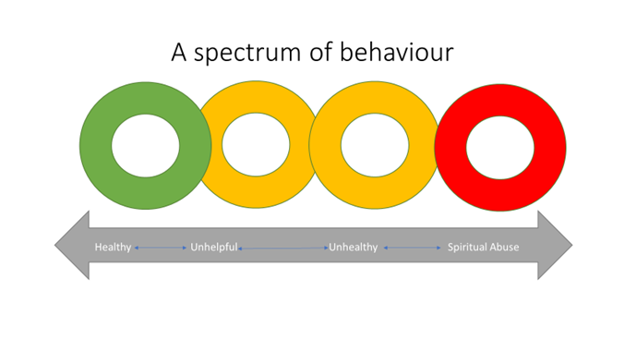

Slide 14


Slide 15
7 Now to each one the manifestation of the Spirit is given for the common good. 8 To one there is given through the Spirit a message of wisdom, to another a message of knowledge by means of the same Spirit, 9 to another faith by the same Spirit, to another gifts of healing by that one Spirit, 10 to another miraculous powers, to another prophecy, to another distinguishing between spirits, to another speaking in different kinds of tongues,[a] and to still another the interpretation of tongues.[b] 11 All these are the work of one and the same Spirit, and he distributes them to each one, just as he determines.

Slide 16

The Gift That Keeps on Giving
The joy of experiencing God using you
The Gifts you have are chosen by God for you
The gifts help you develop our faith
Your gifts help the church develop
Using your gifts is an act of worship

