Slide 1


When you hear "Spiritual Gifts" what do you think of?

Slide 2


Three Gifts: Faith, Tongues, and Miracles in Action
Working Together for God's Kingdom Scripture: "Now to each one the manifestation of the Spirit is given for the common good." - 1 Corinthians 12:7

Slide 3

Moving Mountains Through Divine Conviction
FAITH is;
The special conviction God gives to see His power and act with unwavering confidence in His promises"

Slide 4

Faith Means
Believing God's promises
Acting with confidence in God's ability
Advancing Christ's cause even when others hesitate
Expecting and attempting great things for God
Reality of living sacrifices
Notes:
This slide focuses on the significance of faith in our lives. It empowers us to trust in God's promises, inspires us to take action even when faced with challenges, and serves as the foundation for achieving remarkable things in our spiritual journey.
4

Slide 5
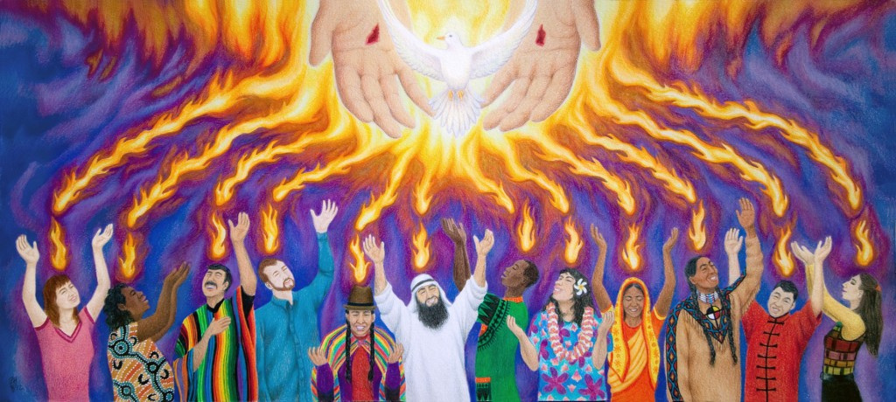
The Gift of Tongues
Building Bridges for the Gospel
Scripture: Acts 2 & Mark 16:17-18 Key
Not just foreign languages - breaking down ALL barriers
ThePhoto by PhotoAuthor is licensed under CCYYSA.
Notes:
This slide highlights the gift of tongues and its role in fostering communication among diverse people. It emphasizes the importance of cultural exchange and how this gift can bridge gaps in understanding, making it essential for building community.
5

Slide 6

Gift of Tongues
Speaking in Unknown Languages
Divine Messages
Edifying the Church
Availability and Willingness
Notes:
The gift of tongues allows individuals to speak in an unknown language. They receive spontaneous messages from God, made known through interpretation. This gift is used to edify the church and involves speaking in languages not learned or understood by the speaker. It requires availability and willingness to be used by God to communicate His messages.
6

Slide 7
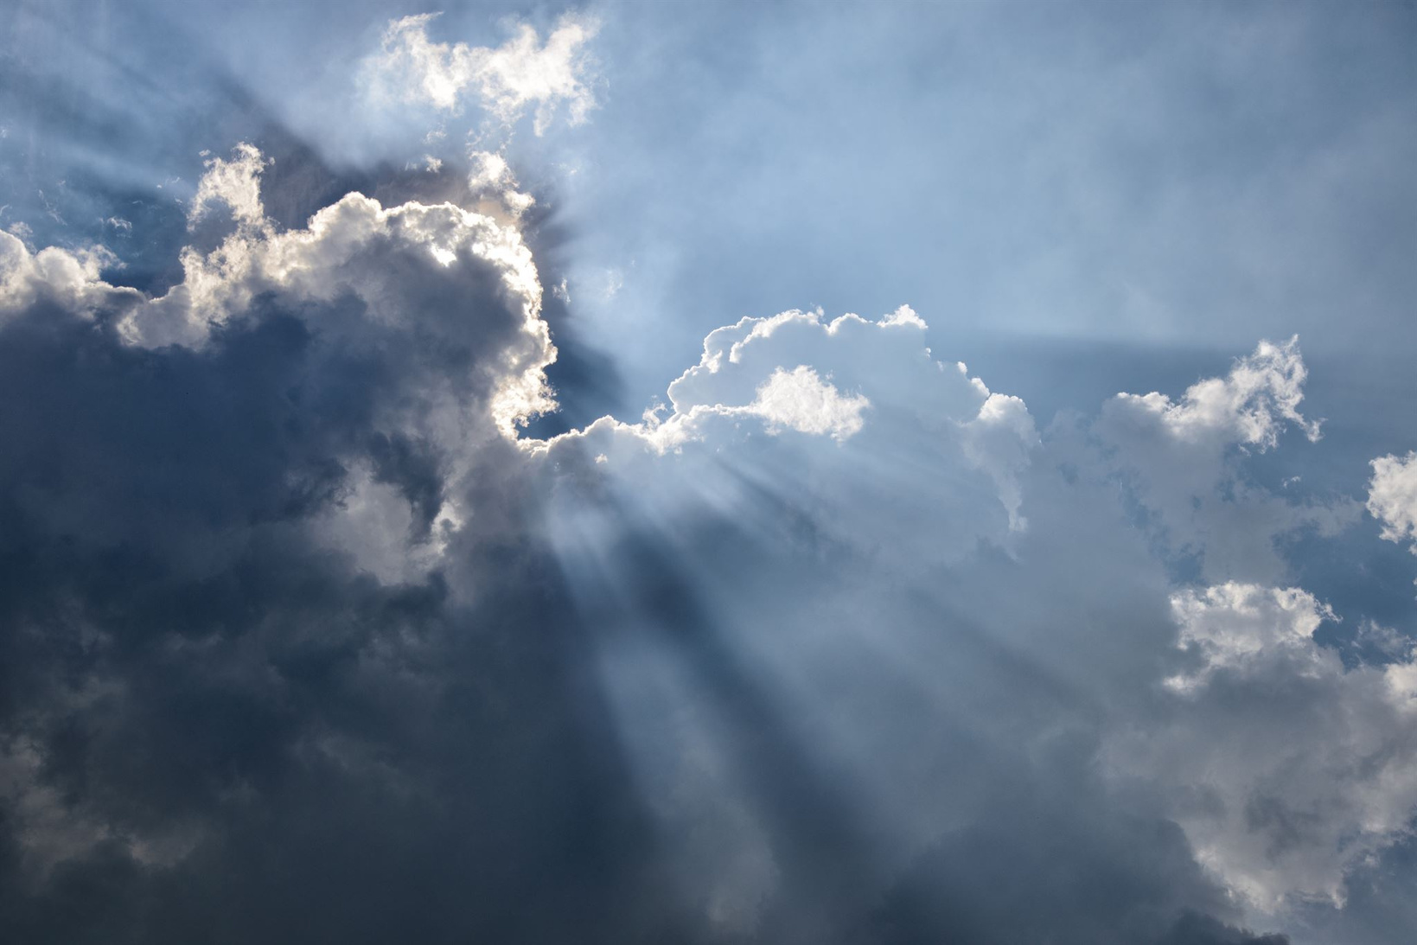
Miracles
Miracles reveal God's presence in our lives.
They encourage us to recognize divine intervention.
Miracles inspire faith in others.
Notes:
This slide explores the power of miracles in revealing God's presence in our lives. It encourages us to recognize divine intervention and how miracles can inspire faith in others, reinforcing the message of hope.
7

Slide 8
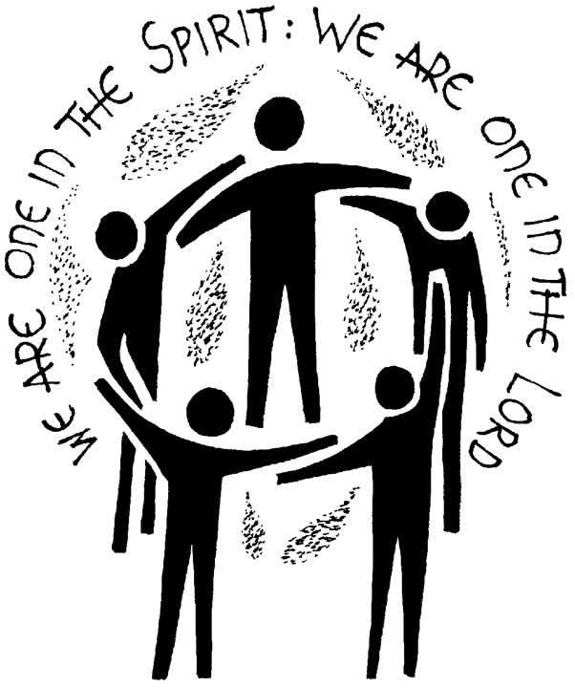
Unity Through Gifts
Spiritual gifts promote unity in the church.
Each gift contributes to the common good.
Together, they advance God's kingdom.
ThePhoto by PhotoAuthor is licensed under CCYYSA.
Notes:
This slide discusses the importance of unity through spiritual gifts. Each gift contributes to the common good, and when used together, they significantly advance God's kingdom, creating a strong and vibrant church community.
8

Slide 9

What gifts
Ways of working out what gifts we have
Self-examination
Experience and testing
Biblical study
Others affirming us
Notes:
This slide reflects on the wisdom of historical church leaders who emphasized the authenticity of spiritual gifts. They cautioned against using these gifts for personal glory and highlighted the importance of discernment in their application.
9

Slide 10

Reflecting on Your Gifts
Identify which gift resonates with you.
Consider the barriers you can help bridge.
Take action in faith this week.
Notes:
This slide encourages reflection on personal spiritual gifts. It prompts individuals to identify which gift resonates with them, consider how they can help bridge barriers, and take meaningful action in faith during the upcoming week.
10

Slide 11

No one is unemployed in the Kingdom
1
2
3
Removing fear
Unlocking potential
Unleashing the Spirit

Slide 12
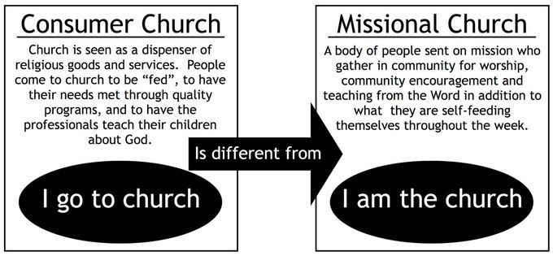

Slide 13

Taking Action
Encourage someone in their faith journey.
Engage in meaningful conversations to build bridges.
Recognize and share God's work in your life.
Rejoice in the Lord
Notes:
This slide outlines practical actions for the week ahead. It encourages individuals to inspire others in their faith journeys, engage in meaningful conversations to build connections, and recognize and share the work of God in their lives, fostering a supportive community.
13

Slide 14
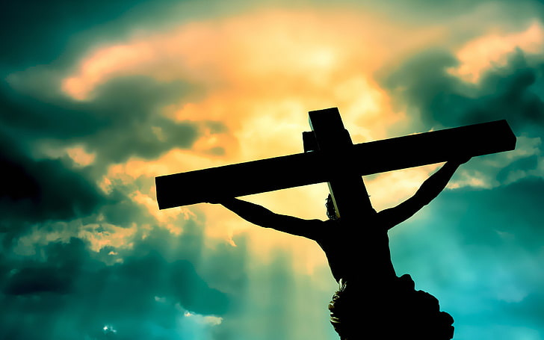
Conclusion and Prayer
Thank God for the gifts He has given.
Pray for guidance to use gifts wisely.
Commit to unity and love in the church.
Be a living sacrifice to the one who became a dying sacrifice.
Notes:
This concluding slide invites participants to thank God for the gifts they've received. It encourages prayer for guidance in using these gifts wisely and a commitment to fostering unity and love within the church community.
14

