Slide 1
Matthew 3:1-12 NIV
In those days John the Baptist came, preaching in the wilderness of Judea ² and saying, “Repent, for the kingdom of heaven has come near.” ³ This is he who was spoken of through the prophet Isaiah:
“A voice of one calling in the wilderness,
‘Prepare the way for the Lord,
make straight paths for him.’”
⁴ John’s clothes were made of camel’s hair, and he had a leather belt around his waist. His food was locusts and wild honey. ⁵ People went out to him from Jerusalem and all Judea and the whole region of the Jordan. ⁶ Confessing their sins, they were baptized by him in the Jordan River.

Slide 2
⁷ But when he saw many of the Pharisees and Sadducees coming to where he was baptizing, he said to them: “You brood of vipers! Who warned you to flee from the coming wrath? ⁸ Produce fruit in keeping with repentance. ⁹ And do not think you can say to yourselves, ‘We have Abraham as our father.’ I tell you that out of these stones God can raise up children for Abraham. ¹⁰ The axe is already at the root of the trees, and every tree that does not produce good fruit will be cut down and thrown into the fire.

Slide 3
¹¹ “I baptize you with water for repentance. But after me comes one who is more powerful than I, whose sandals I am not worthy to carry. He will baptize you with the Holy Spirit and fire. ¹² His winnowing fork is in his hand, and he will clear his threshing floor, gathering his wheat into the barn and burning up the chaff with unquenchable fire.”

Slide 4
Luke 3:10-14 NIV
¹⁰ “What should we do then?” the crowd asked.
¹¹ John answered, “Anyone who has two shirts should share with the one who has none, and anyone who has food should do the same.”
¹² Even tax collectors came to be baptized. “Teacher,” they asked, “what should we do?”
¹³ “Don’t collect any more than you are required to,” he told them.
¹⁴ Then some soldiers asked him, “And what should we do?”
He replied, “Don’t extort money and don’t accuse people falsely—be content with your pay.”

Slide 5
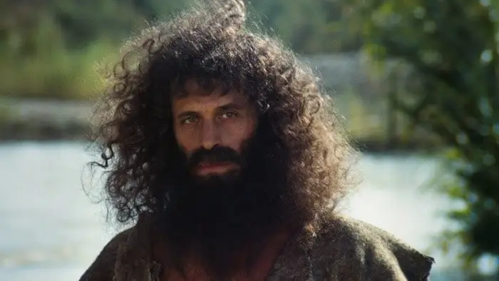

Slide 6
Luke 3:10-14 The Message
⁷⁻¹⁰ When John realized that a lot of Pharisees and Sadducees were showing up for a baptismal experience because it was becoming the popular thing to do, he exploded: “Brood of snakes! What do you think you’re doing slithering down here to the river? Do you think a little water on your snakeskins is going to make any difference? It’s your life that must change, not your skin! And don’t think you can pull rank by claiming Abraham as father. Being a descendant of Abraham is neither here nor there. Descendants of Abraham are ten a penny. What counts is your life. Is it green and flourishing? Because if it’s deadwood, it goes on the fire.

